Slide 1
CSE514 – Datamining Fall 2022 Introduction
Cynthia Ma
Department of Computer Science
Washington University in St. Louis
czma@wustl.edu

Slide 2
What is Data Mining?
Finding something interesting in a given set of data
Mining knowledge from data
As an engineer:
reverse engineer the underlying processes that generate the observations of a given dataset
As a statistician:
define a model M that maximizes prob(M|D) for a given dataset D

Slide 3
Why Data Mine?
Knowledge acquisition is expensive (for humans)
It takes time and money to train human experts
It takes time and money to pursue specific knowledge
Underlying processes can be too complex to learn
Data acquisition is cheap (for machines)
Fast processing for recording data
Fast network connections for communicating data
Large storage space for saving data

Slide 4

Major components of Data Mining systems
Knowledge Base
User Interface
Processed Data
Data Warehouse
Data Mining Engine
Learned Model
Pattern Evaluation
Cleaning
Selecting
Transforming
Raw Data
Data Warehouse

Slide 5
What does Data Mining actually do?
Outlier detection: Identification of unusual data points
Association rules: Searching for relationships between variables without causality
Clustering: Discovering groups of “similar” samples
Classification: Predicting a qualitative label for a sample
Regression: Predicting the quantitative value of dependent variables from independent variables
Summarization: Producing a compact description of data

Slide 6
How do we describe data?
Data type – quantitative, qualitative, or a complex mix
Size of dataset – # of datapoints/objects/samples
Data dimensionality – number of features/variables that describe a data point
Quality of data – presence of missing/erroneous or even redundant values

Slide 7
Data type
Quantitative/Numerical
numbers, can be ranked, has distance b/w points
Discrete: countable, integer values, e.g. class size
Continuous: not countable, real values, e.g. height
Qualitative/Categorical
names/labels, no distance b/w points
Nominal: can’t be ranked, e.g. gender
Ordinal: can be ranked, e.g. military rank

Slide 8
What is “big” data?
A data point is a single object or sample in your set
A patient in a medical database
An array of gene expression values from a sample of cells
An image in a photo-set
A song in your music library
The dimensionality of a data point is the number of features that describe the data point
Complex mix of data and data types

Slide 9
Curse of dimensionality
Difficult to visualize and/or understand
Increases storage and computation cost
More likely to result in high sparsity
How to handle unknown values?
How to detect patterns in sparse data?

Slide 10
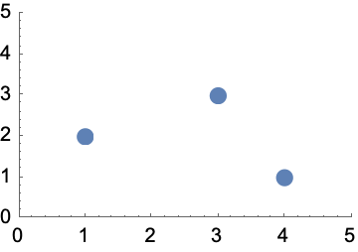
Analyzing data samples with geometry
Number of features = dimensions
A sample in a dataset with multiple feature values is often represented as a vector
Ex. X1 = [ 1, 2 ]
X2 = [ 3, 3 ]
X3 = [ 4, 1 ]

Slide 11
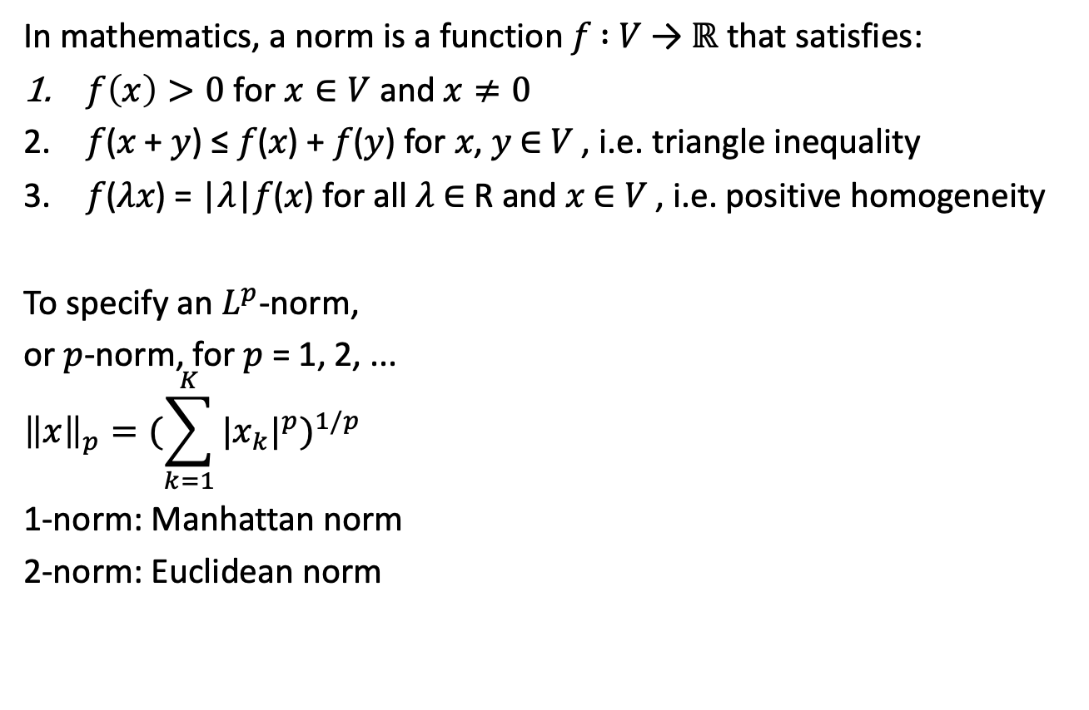
Magnitude of data vectors with norms
In mathematics, a norm is a function 𝑓 ∶ 𝑉 → $ℝ$ that satisfies:
$f\left(x\right)>0$ for $x∈V$ and $x≠0$
𝑓(𝑥 + 𝑦) ≤ 𝑓(𝑥) + 𝑓(𝑦) for 𝑥, 𝑦 ∈ 𝑉 , i.e. triangle inequality
𝑓(𝜆𝑥) = |𝜆|𝑓(𝑥) for all 𝜆 ∈ R and 𝑥 ∈ 𝑉 , i.e. positive homogeneity
To specify an $L^{p}$-norm,
or 𝑝-norm, for 𝑝 = 1, 2, ...
$${\left\|x\right\|}_{p}={(\sum_{k=1}^{K}{{|x_{k}|}^{p}})}^{1/p}$$
1-norm: Manhattan norm
2-norm: Euclidean norm

Slide 12
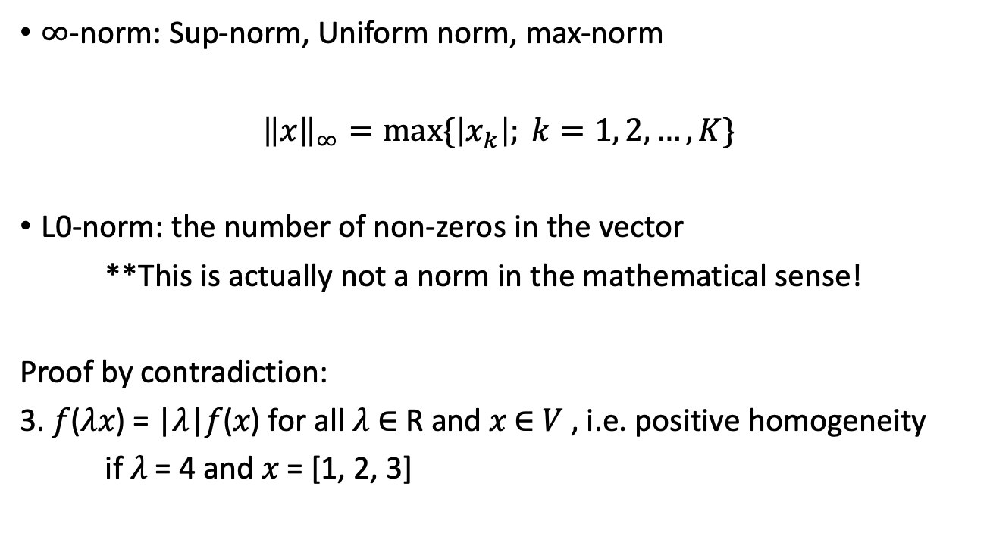

Special $L^{p}$-norms
$∞$-norm: Sup-norm, Uniform norm, max-norm
${\left\|x\right\|}_{∞}=max\{\left|x_{k}\right|; k=1, 2,…, K\}$
L0-norm: the number of non-zeros in the vector
**This is actually not a norm in the mathematical sense!
Proof by contradiction:
3. 𝑓(𝜆𝑥) = |𝜆|𝑓(𝑥) for all 𝜆 ∈ R and 𝑥 ∈ 𝑉 , i.e. positive homogeneity
if 𝜆 = 4 and 𝑥 = [1, 2, 3]

Slide 13
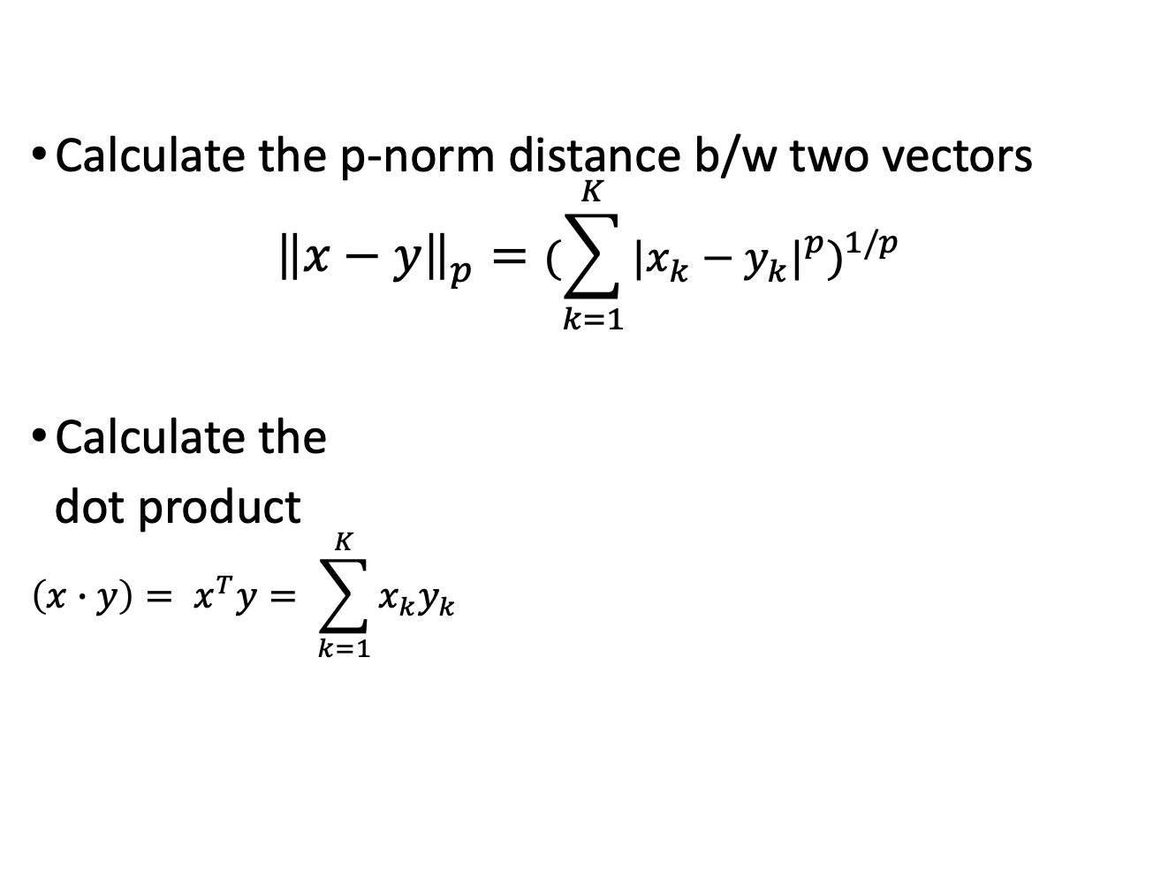
Distance/similarity between samples
Calculate the p-norm distance b/w two vectors
$${\left\|x−y\right\|}_{p}={(\sum_{k=1}^{K}{{|x_{k}−y_{k}|}^{p}})}^{1/p}$$
Calculate the
dot product
$$\left(x∙y\right)= x^{T}y= \sum_{k=1}^{K}{x_{k}y_{k}}$$

Slide 14
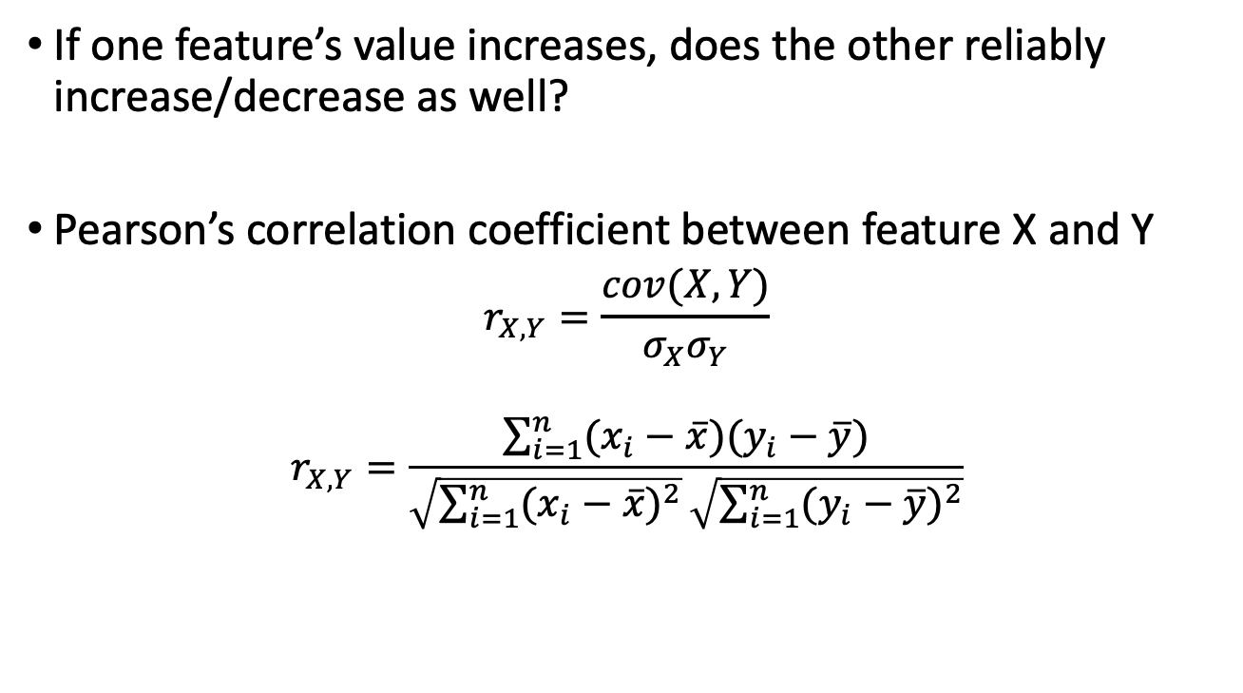
Distance/similarity between features
If one feature’s value increases, does the other reliably increase/decrease as well?
Pearson’s correlation coefficient between feature X and Y
$$r_{X,Y}=\frac{cov(X, Y)}{σ_{X}σ_{Y}}$$
$$r_{X,Y}=\frac{\sum_{i=1}^{n}{(x_{i}−\overline{x})(y_{i}−\overline{y})}}{\sqrt{\sum_{i=1}^{n}{{(x_{i}−\overline{x})}^{2}}}\sqrt{\sum_{i=1}^{n}{{(y_{i}−\overline{y})}^{2}}}}$$

Slide 15
Homework
Submit HW 0: Course Questionnaire
Sign up on Piazza
Visit this spreadsheet before Wednesday’s class
https://tinyurl.com/featuresOfMyLunch
Add observable features of your lunch
See the first column for examples
Choose a column for your entry and add as many features as you like
Repeating values from other people’s entries is ok
+1 extra credit point on HW0 if you add your name and ID to first column

